Slide 1
DNS-Chord: Dig-ing to greater DNS Resolution Efficiency
Dheeraj Ramchandani, Tarush Abhaya Jain, Ben Michalowicz, Ghanendra Piplani

Slide 2
Agenda
Motivation
Distributed Hash Table
What is Chord?
Previous Work
Data Selection
Performance Analysis
Load Distribution between nodes
Different node configurations
Comparison of query types to runtime
Team Member Contributions
Questions

Slide 3
Motivation
Related Work
DNS is foundation of Internet
Current DNS system is hierarchical in nature
The current project is distributed
‘Serving DNS using a Peer-to-Peer Lookup service’ - This project explored a distributed hash table approach using the Chord protocol for DNS. The latency evaluations showed the large gap between hierarchical DNS and the slow DHT based DNS.
‘DNS and Distributed Hash Tables Not Quite Perfect Together’ - This MIT based experiment of DNS in a distributed system evaluated various metrics like latency, robustness, network outages, functionality, and administration and found the DHT based DNS lagging.
Notes:
Previous content:
The Chord system is a lookup protocol for internet applications
Which other internet application could be better than DNS that is used for “lookup”?
DNS is foundation of the internet.
Current DNS system relies on 13 root servers and is hierarchical in nature.
Susceptible to attacks
If root nodes are attacked, failure recovery would take much time.
Chord makes it highly scalable and distributed and performs faster lookup as compared to traditional DNS
In case of failure of a few nodes, the system will not stop working and can be brought back up in lesser time.
Peer-to-peer architecture makes it less susceptible to failures.

Slide 4
Distributed Hash Table and Consistent Hashing
Distributed system for lookup service similar to a hash table.
Hash value is key and IP address is value.
Add/Remove nodes with minimum overhead of re-distributing keys.
Distribute keys to nodes using DistAlgo for their efficient distribution.
Notes:
Prev content:
A DHT is a distributed system that provides a lookup service similar to a hash table: key-value pairs are stored in a DHT, and any participating node can efficiently retrieve the value associated with a given key.
The main advantage of a DHT is that nodes can be added or removed with minimum work around re-distributing keys
With DistAlgo, this can be split up among many nodes, with each carrying a portion of the HashTable

Slide 5
Chord Protocol
Distributed databases with ring structure for load balancing and distribution.
Keys assignment to nodes and their discovery.
Consistent hashing using SHA algorithms suites originally using SHA1.
Chord == DNS using hashing.
O(log(n)) constant lookup complexity irrespective of search dataset.

Slide 6
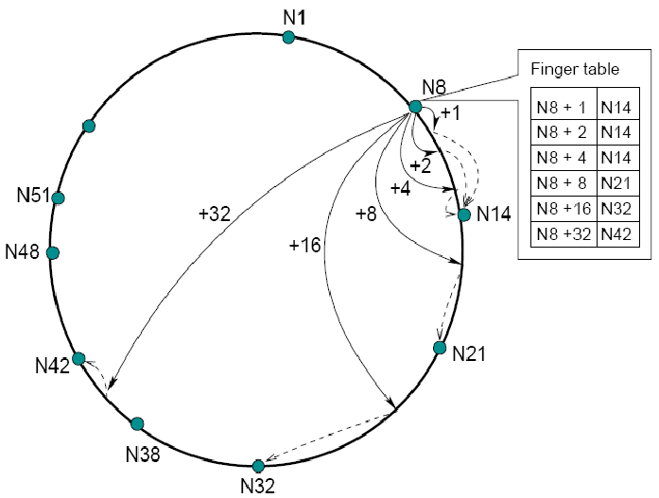
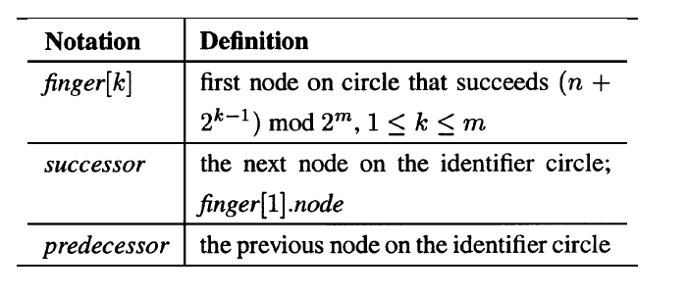
Chord Ring Topology
Ref: Chord-Scalable peer to peer lookup protocol

Slide 7
Chord Architecture
Current node knows only about the immediate successor.
Acceleration of lookups.
Finger table entry = ChordNode Id + IP Address : Port Number
Async ‘Stabilization’ protocol in Chord to keep finger tables and successors updated.
Notes:
Prev Content:
Each node needs only to know how to contact its current successor node on the identifier circle.
To accelerate lookups, Chord maintains additional routing information
A finger table entry includes both the Chord identifier and the IP address (and port number) of the relevant node
Chord must ensure that each node’s successor pointer is up to date. It does this using a “stabilization” protocol that each node runs periodically in the background and which updates Chord’s finger tables and successor pointers.

Slide 8
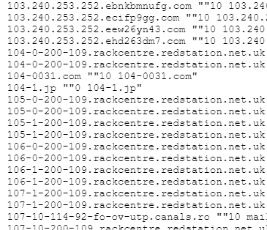
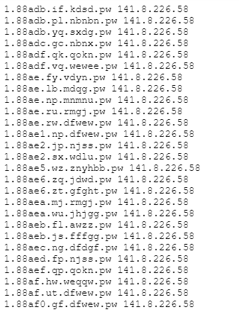
Data Processing: Sources
Started with OpenData/Rapid7/ForwardDNS database for records
Pros:
Plenty of domain names (TLD’s, Name Servers, etc.)
Massive selection to choose from
JSON Format: Easy to parse
Cons:
Massive selection: Running out of space on single computer
Complex hostnames: not as easy to parse and examine
Numerous common prefixes: Very little variety in domain names and results.
Workaround: Move to Alexa’s top 1 million websites
Just hostnames: Easy to distinguish and find, even with similar prefixes
Small enough to use, large enough for variety

Slide 9
Data Processing: Obtaining records
Use of DNSPython for querying
Searching for A, MX, NS records from top 1 million sites
Caveat: Not all hostnames may have each type of record
Some queries even resulted in an error
Break after 400K successful hostname queries
DNSPython returns all queries, like ‘dig,’ so take only the first index of the provided queries
One computer, one person, and 48 hours of continuous runtime
Output file for use in Chord: (url, A-record, MX-record, NS-record)
Note: Parsing out numerical priority in MX record “ANSWER” section needed

Slide 10
Data Processing: Get “dig” runtimes
Parse 400K hostnames from output file
Bash script to split output file by whitespace
Obtain runtimes through “dig,” Linux’s “time” tool, for A, MX, NS records
One person, one computer… and eight hours of continuous parsing of runtimes
Separate bash scripts for each record to keep data clean, and easy to plot
Notes:
For our Chord implementation: 400K took too long to obtain results, so we scaled down to 10K records
Large data amount

Slide 11
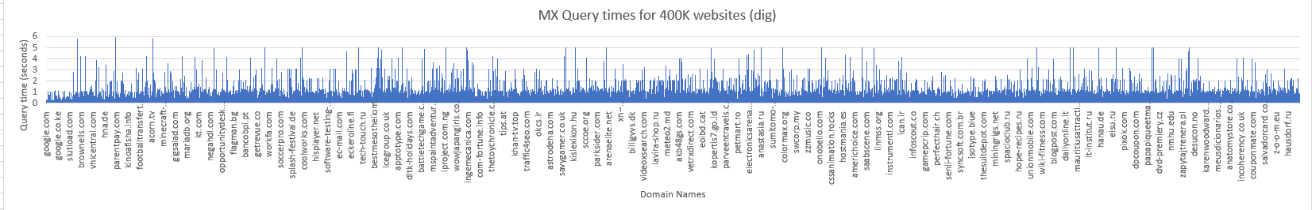
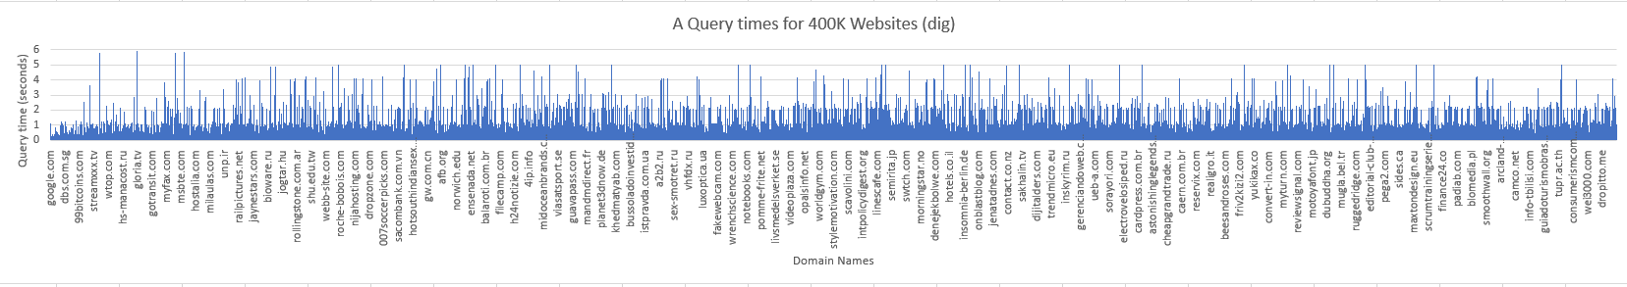
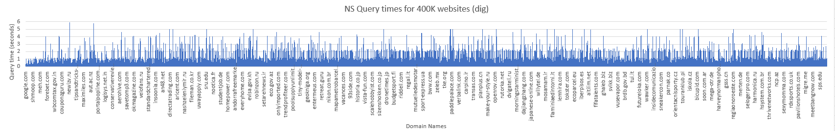
Notes:
Note: More popular sites have query times well under 1 second. As the popularity of sites decreases, so does the query time, though other factors are also involved, such as distance from US servers (based on TLD, CCTLD’s, and other factors, as well as strength of connection)

Slide 12
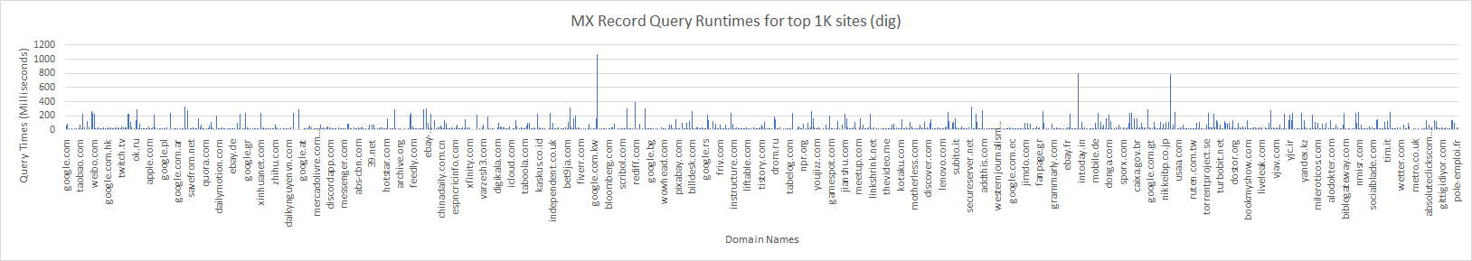
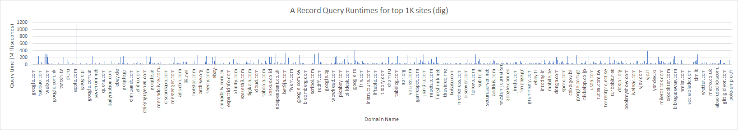
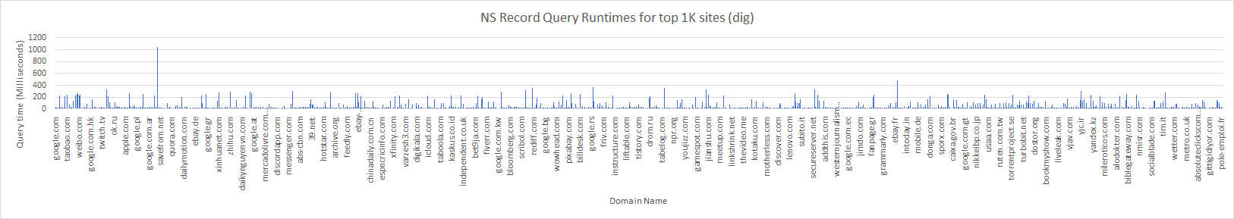

Slide 13
pyDistAlgo
High-level language for implementing distributed algorithms, the main “weapon” of our choice
Queries of message histories
Control flow for sending and receiving messages
Distributed processes and message sending
Easy configuration, based on Python3
Set up channels, relay messages across processes and synchronization of processes

Slide 14
Implementation 1: Setup
Chord
Main
SHA3
Node₁
FingerTable₁
Record set
Node₂
FingerTable₂
….
….
Node_{n}
FingerTable_{n}

Slide 15
Implementation 2: Resolution
Chord
find_next_node
Node₁
FingerTable₁
Hostname
Ex: abc.com A
Main
Hostname hash value
Client
next_node
User
Node₂
FingerTable₂
get
IP address
IP address
….
….
result
Node_{n}
FingerTable_{n}

Slide 16
Experiments
Hierarchical DNS vs Chord based DNS
Hashing vs Look up time
Tested between: SHA-1, SHA-224, SHA-256, SHA-512, ADLER32, CRC32,
Number of nodes vs Look-up time:
Test seven different node configurations, ranging from ten to one thousand nodes
Finger table size - Lookup time
Small (15), Medium (30), and Large (45) Finger Table sizes were examined
Path length vs Timeouts
Node Failure Rate vs Look up time
Calculated expected changes in lookup time with node failure rate
Node failure rate vs Path length

Slide 17
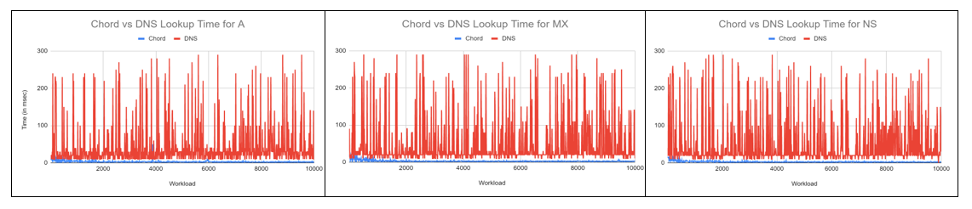
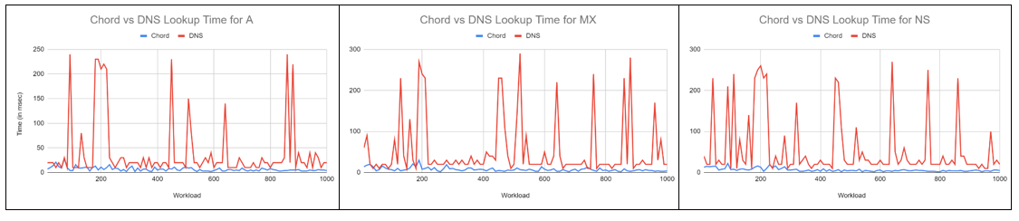
Results: Chord versus DNS Lookup Times
Notes:
Hierarchical vs Chord Ring

Slide 18
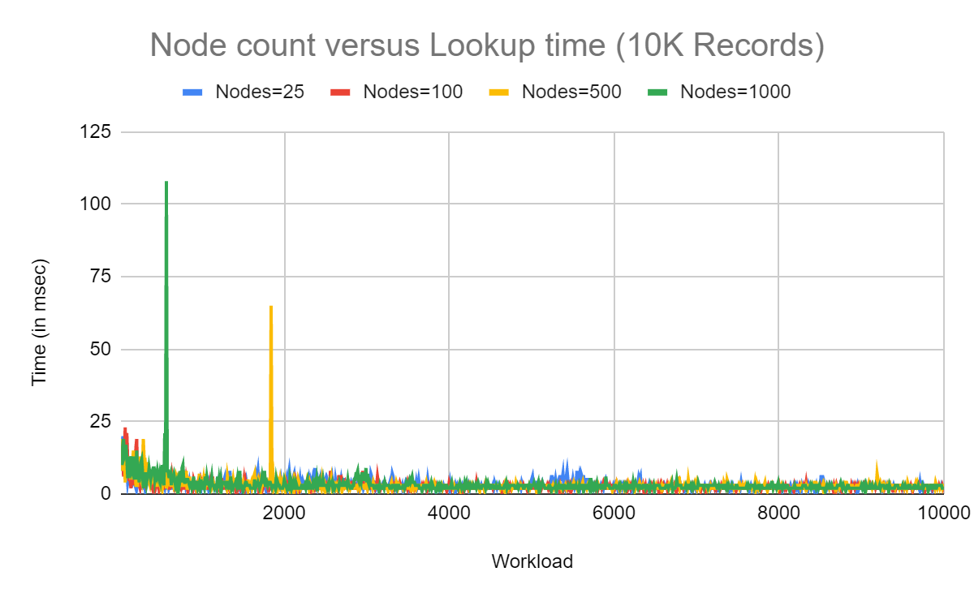
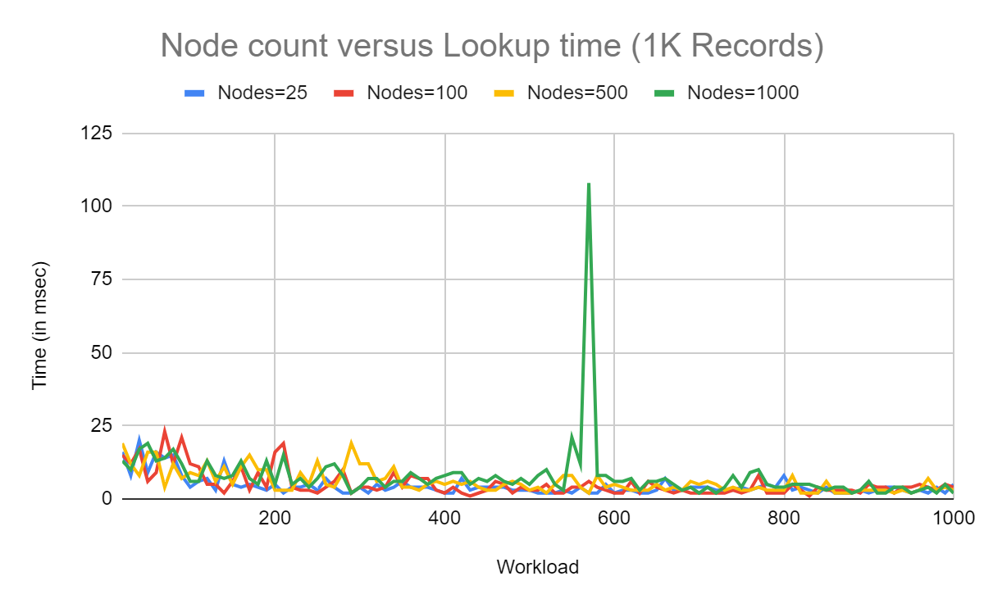
Results: Node Count vs Lookup Time

Slide 19
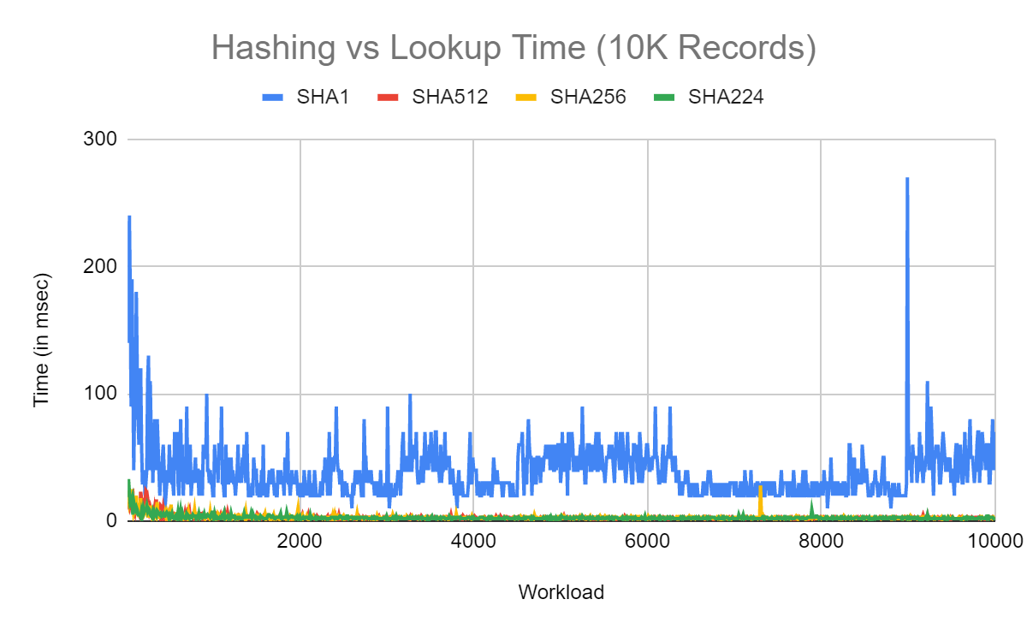
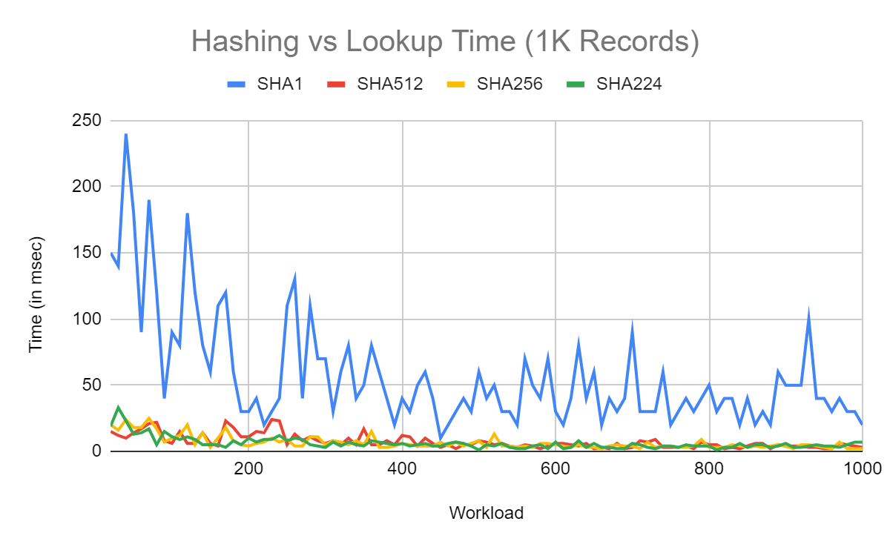
Results: Hashing Function vs Lookup Time

Slide 20
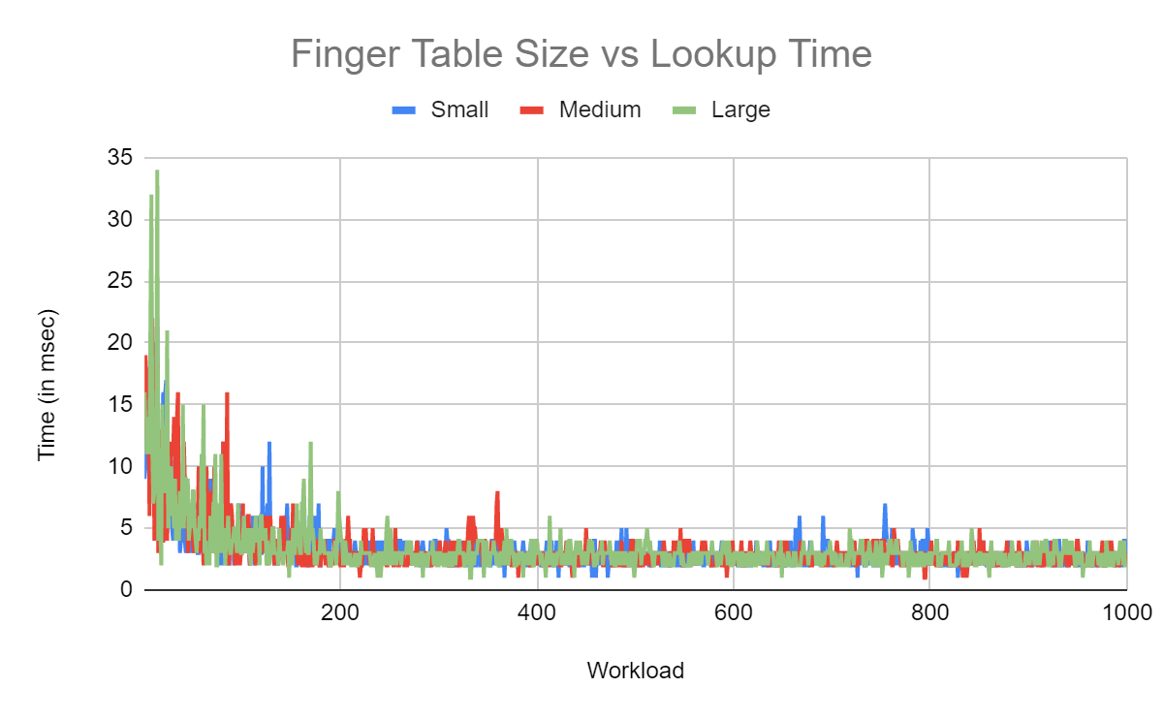
Results: Finger table Size vs Lookup Time

Slide 21
Future Work
Addition/deletion of nodes and Chord’s stabilization protocol.
Node validation to prevent faulty/inconsistent nodes appearing in the ring.
Notes:
Addition and deletion of nodes in the DNS service’s Chord ring is supported by a stabilization protocol.

Slide 22
Conclusion
Our P2P DHT DNS-Chord protocol shows faster lookup compared to existing hierarchical system by 13-17%.
Chord’s high probability of finding next node due to O(logn) lookup time
SHA-3 Hashing ensures collision prevention at a higher value of nodes.

Slide 23

Demo

Slide 24
References
[1] Russ Cox et. al, “Service DNS using a Peer-to-Peer Lookup Service,” 2001,
[2] Jaeyeon Jung, Emil Sit, Hari Balakrishnan, and Robert Morris, “DNS performance and the effectiveness of caching.”
[3] Ian Stoica et. al, “Chord: A Scalable Peer-to-peer Lookup Protocol for “Internet Applications”.
[4] Mozilla’s Cipherscan Repository:”Alexa Top 1 million Websites”
[5] Yanhong A. Liu et. al, “From Clarity to Efficiency for Distributed Algorithms.”
[6] Yanhong A. Liu et. al, “DistAlgo Language Description, revised as of 2017”
[7] Ian Clarke et. al, “Freenet: A Distributed Anonymous Information Storage and Retrieval System”,
[8] A. Bakker et. al, “The Globe Distribution Network.”

Slide 25
Team Member Contributions
Ben: Data collection Data pre-processing Obtaining dig-query times Filtering top 1k sites data for ChorDNS lookup Preprocessing general data for ChorDNS lookup Chord configuration file and configuration settings code DistAlgo Unit testing Integration testing
Tarush: Prior work evaluation
DistAlgo node setup code DistAlgo node startup code DistAlgo node stop code Chord query input processing code
Experiment with varying node values (10 -- 1000) Experiment with shifting workload (1000 -- 25000) Result graph generation - Lookup time vs Node
Dheeraj: Prior work evaluation Hash function setup code (SHA1, SHA3, etc.) Chord finger table setup code Chord query formation code Chord query processing & parsing code Chord find next node for query resolution code Experiment with different SHA-Suite functions Query lookup Unit testing Result graph generation - Lookup time vs Hash function
Ghanendra:
Generating lookup data for 1 million websites DistAlgo node message queue and message structure code
Chord find closest preceding for finger table resolution code Chord node data population code Chord query resolution code Experiment with different hashing functions Chord protocol Unit testing Result graph generation - Expected Lookup time vs Node Failure
Notes:
Design and implementation of interactive Chord in CLI;

Slide 26
Thank you/ Questions?

